Slide 1
Assessing Expression Bias Between Bulk and Single Nucleus RNAseq
Saelin Bjornson, Vladimir Nikolic, Jordan Sicherman and Lucía Quesada-Ramírez
STAT 540 Project, March 31st 2020

Slide 2
Introduction to snRNAseq

Slide 3
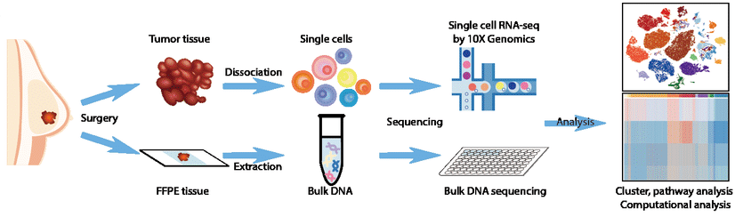
Single-cell RNAseq
Bulk RNA-seq: Quantification of average, population-level gene expression
Single cell RNA-seq: Quantification gene expression in thousands of individual cells
Resolution of cellular heterogeneity has important implications in cell type discovery, cellular differentiation, stochastic expression analysis and lineage reconstruction¹
Image : Yin J et al. 2018. Comprehensive analysis of immune evasion in breast cancer by single-cell RNA-seq. BioRxiv DOI: 10.1101/368605
Rosto R etal. 2017. Computational approaches for interpreting scRNA‐seq data. FEBS Lett 591(15): 2213-2225. DOI: 10.1002/1873-3468.12684

Slide 4
Experimental Workflow
Single Nucleus RNAseq
Tissue Sectioning
Tissue Dissociation
Cell Enrichment
Single Cell Isolation
Cell Lysis
RNA Extraction
Library Prep
Sequencing
A micrometer section of tissue is withdrawn from the sample
Mechanical
Enzymatic
Microfluidics
Optional
Centrifugation
Filtration
Sedimentation
AB Labeling
FACS
Bead-based
Dead cell removal
Droplet-based
Microwell-based
Microfluidics
FACS
LCM
Cells are lysed to release DNA/RNA
RNA is selected for and isolated
Protocol-specific library preparation steps to get ready for sequencing
Generate reads
3’ -only
5’-only
Full-length transcripts

Slide 5
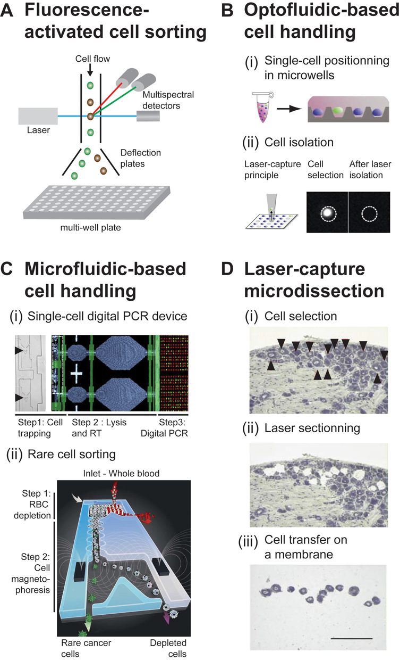
Single Cell Isolation
FACS
Optofluidics
Microfluidics
LCM
Saliba, AE et al. 2014. Single-cell RNA-seq: advances and future challenges. Nucleic Acid Res 42(14):8845-8860. DOI: 10.1093/nar/gku555

Slide 6
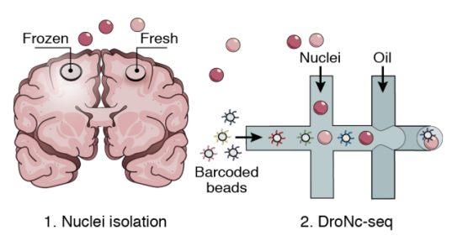
Single Nucleus RNAseq (snRNAseq)
scRNAseq requires viable, intact cells (not frozen) for sequencing
Harsh tissue dissociation can disrupt sensitive cell types, limiting interpretability
An alternative: single nucleus RNAseq
scRNAseq and snRNAseq have been found to have high concordance in expression of cell-specific markers and functions, but with less reported cell bias than scRNAseq^{1, 2, 3}.
Lake, BB et al. 2017. A comparative strategy for single-nucleus and single-cell transcriptomes confirms accuracy in predicted cell-type expression from nuclear RNA. Sci Rep DOI:10.1038/s41598-017-04426-w
Single-nucleus RNA-seq of differentiating human myoblasts reveals the extent of fate heterogeneity
Comparative analysis of kidney organoid and adult human kidney single cell and single nucleus transcriptomes

Slide 7
Bioinformatics
Library Prep
Sequencing
After sequencing, scRNAseq data processing can include:
De-multiplexing single cells by barcodes
UMI summation and normalization
Correcting for “drop out”
Dimensionality reduction and feature selection
Identify and removing cells that have been compromised by preparation protocols
By features such as expression patterns of GO terms, # of aligned reads, # exonic reads, # detected genes, # mitochondrial reads, transcriptomic variance etc.¹
Are some cell types more likely to be compromised than others?
Ilicic T et al. 2016. Classification of low quality cells from single-cell RNA-seq data. Genome Biol 17. DOI:10.1186/s13059-016-0888-1

Slide 8
Introduction to RNASeekers

Slide 9
Project Motivation and Hypothesis
scRNAseq (and snRNAseq) is not yet mature and may demonstrate some uncharacterized biases arising from technical procedures
Library preparation protocols may impact cell survival based on morphological/physical/chemical features
If this is the case, it may be detected as differential gene expression between bulk and single-cell data (for the same sample) Why: Cellular proportions will differ between single-cell and bulk (averaged) datasets. This would create differences in the proportional abundance of transcripts pertaining to cell-specific processes.

Slide 10
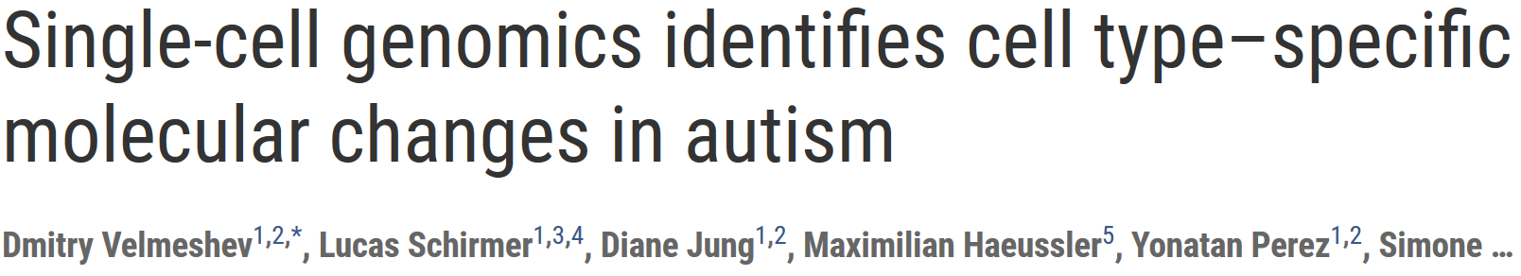
The Data
41 post-mortem brain tissue samples from 32 patients with paired bulk + snRNAseq data.
Since each sample has paired bulk and single nucleus RNAseq, this bias can be examined without worrying about other confounding variables (different individuals, diseases, etc.). This is one of very few studies that has this kind of data!

Slide 11
The Data
41 post-mortem brain tissue samples from 32 patients with paired bulk + snRNAseq data.
snRNAseq:
Isolated by DroNuc-Seq¹ protocol
~3000 nuclei/sample
NovaSeq6000 to average 70k reads/nucleus
Expression quantified by UMIs using 10x Genomics CellRanger
Bulk RNAseq:
Illumina NovaSeq 6000 to average depth of 100x
Habib N et al. 2017.Massively parallel single nucleus RNA-seq with DroNuc-Seq.Nat Method 14:955-958. DOI:10.1038/nmeth.4407
Notes:
DroNuc-seq: Massively parallel singlenucleus RNA-seq with
DroNc-seq

Slide 12
Statistical and Computational Methodology
“Bulkize” the snRNAseq data How: sum UMI counts of each gene for cells originating from the same sample Why: converts ‘cell-level’ data to ‘sample-level’ data, allowing comparison to bulk RNAseq
Perform differential expression analysis between bulkized and bulk data How: limma using the sample of origin, batch and brain region as covariates in the linear model Why: we’re interested in genes with different expression between bulk/bulkized, and want to control for unwanted sources of variation
Perform enrichment analysis on differentially expressed genes How: enrichment by distribution of p-values of cell type marker genes against background Why: to interpret our set of differentially expressed genes and find patterns that would prove or disprove our hypothesis

Slide 13
Results

Slide 14
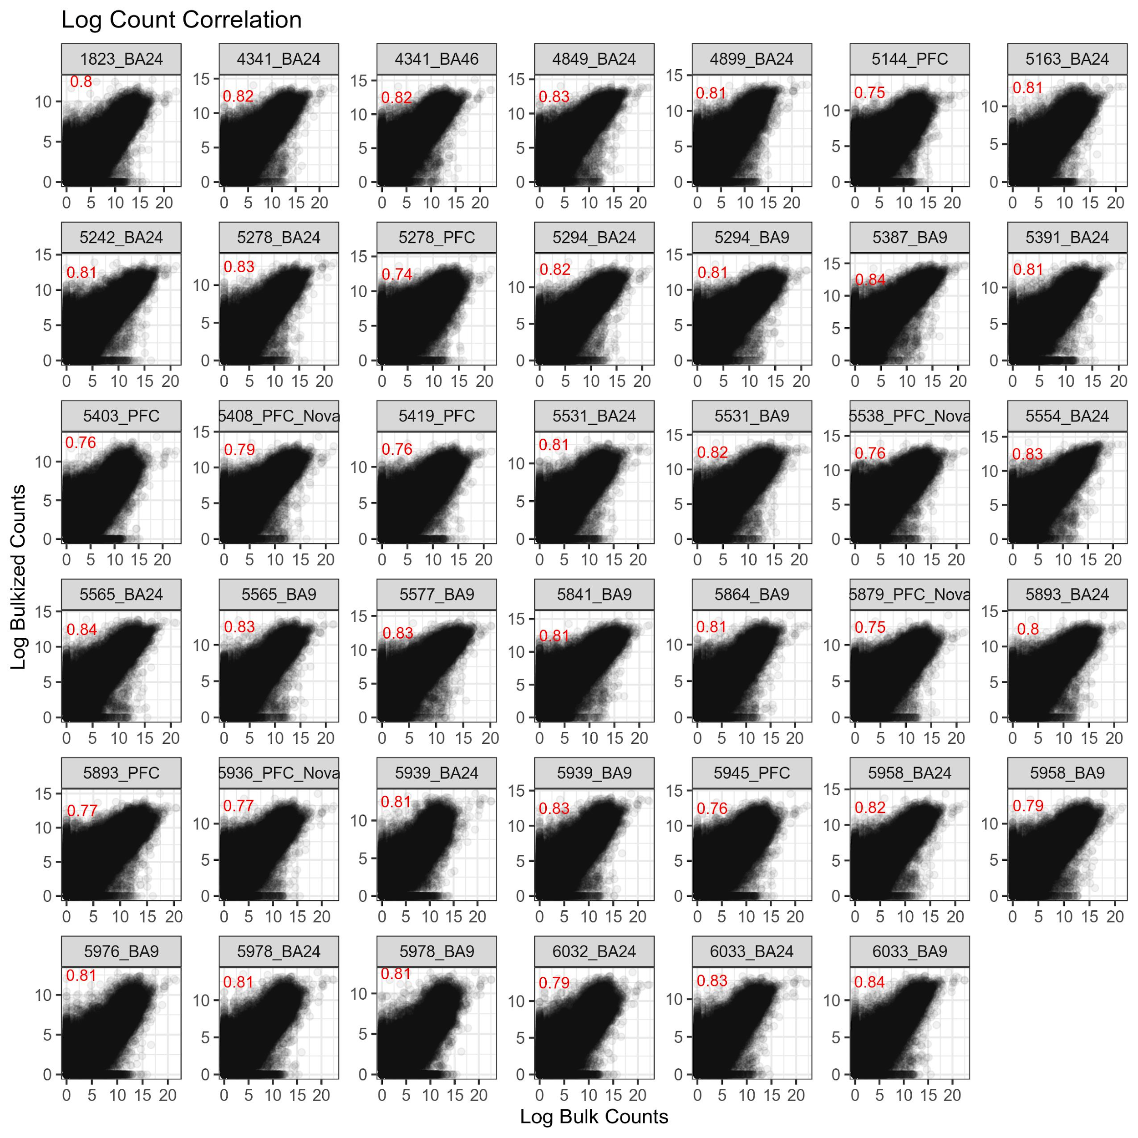
QC: Expression Data Correlates as Expected
Expression must correlate on average Why: if not, differential expression is difficult to interpret
Multiple ways to bulkize Tested (×4): UMI counts and raw counts (voom’d and not)
Highest performance on UMI counts, unvoom’d (mean r² = 0.80, range = 0.76 – 0.84)

Slide 15
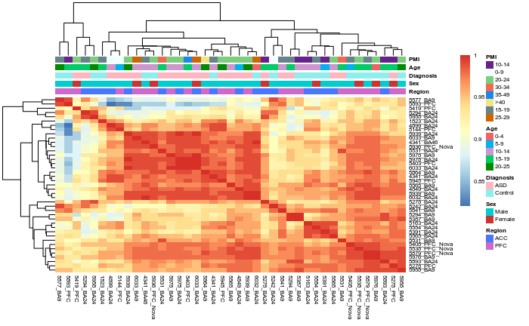
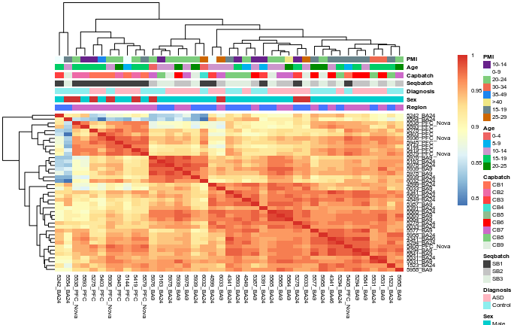
QC: Heatmaps
Minor correlation of samples with brain region and batch, but no other clear correlations.
Bulk
Bulkized

Slide 16
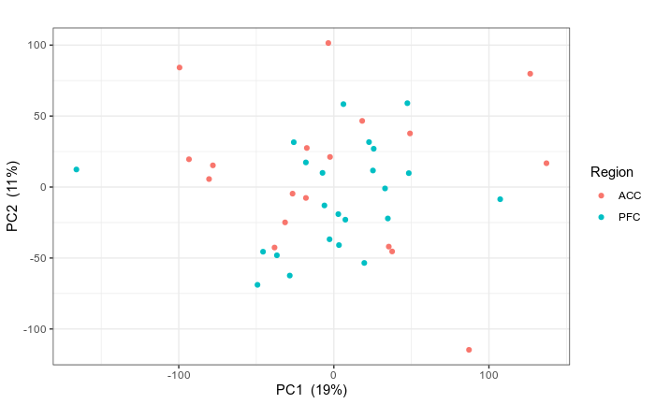
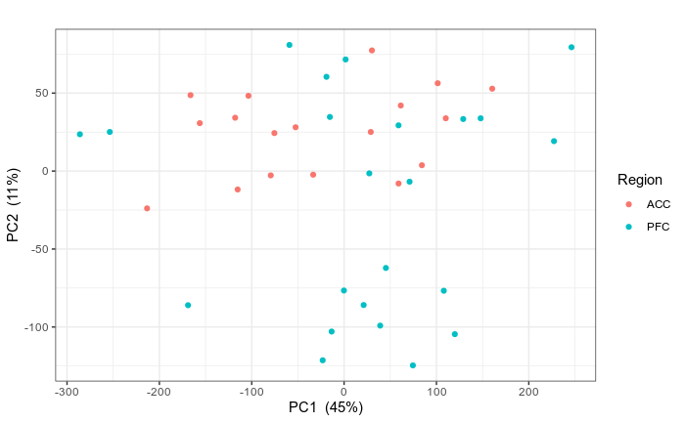
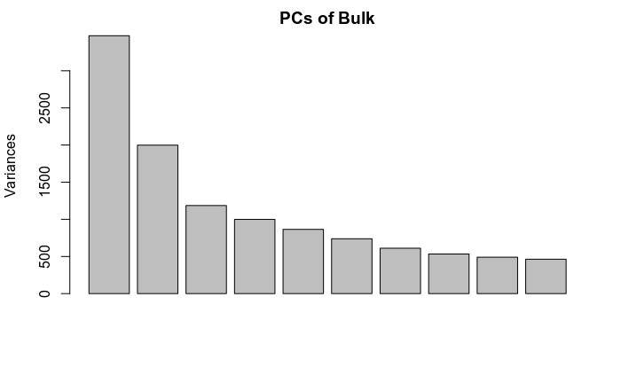
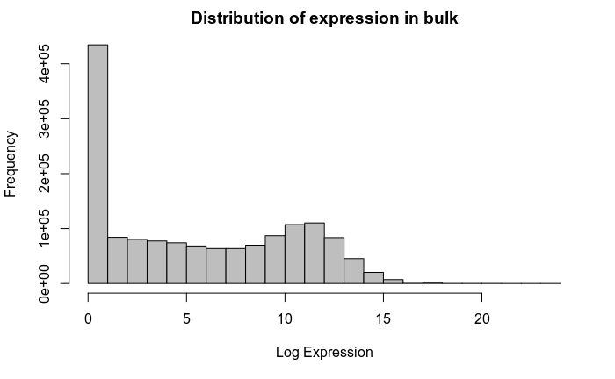
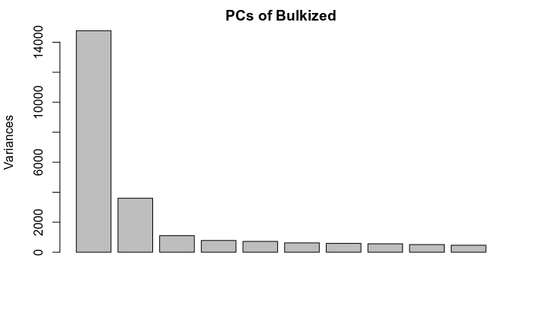
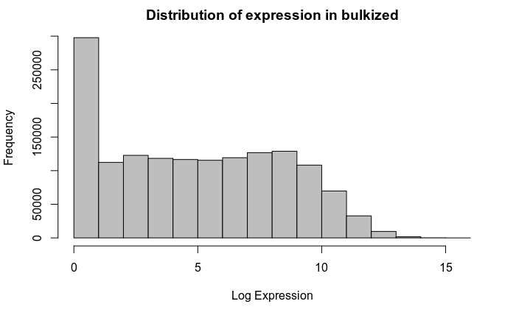
QC: PCA
Bulkized data separates by brain region in the first two principal components
Bulk
Bulkized

Slide 17
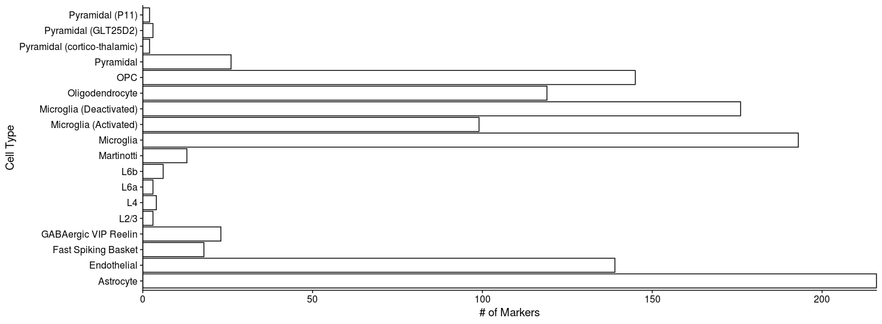
Gene Information and Cell Type Markers
Mouse PFC cell type markers were obtained¹ and converted to human HGNC gene symbols.
Length, GC %, chromosome, and GO terms were fetched using BiomaRt for all genes.
Mancarci BO et al. 2017. Cross-Laboratory Analysis of Brain Cell Type Transcriptomes with Applications to Interpretation of Bulk Tissue Data,” ENeuro. DOI: 10.1523/ENEURO.0212-17.2017.

Slide 18
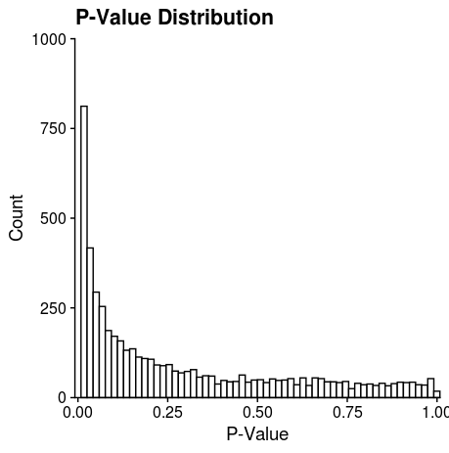
Differential Expression Analysis
89% of genes (32,161) are DE at FDR < 0.05, indicating some general expression level bias.
Theory: The interesting genes (if any) will be the significant ones with the largest logFCs
Reasoning: For those genes... expression deviation ~ bias_{general} + bias_{interesting}
Model: ~style + sample + region
Limiting analysis to only genes with fold changes above 25% of the maximal yields a much more manageable 6566 genes.

Slide 19
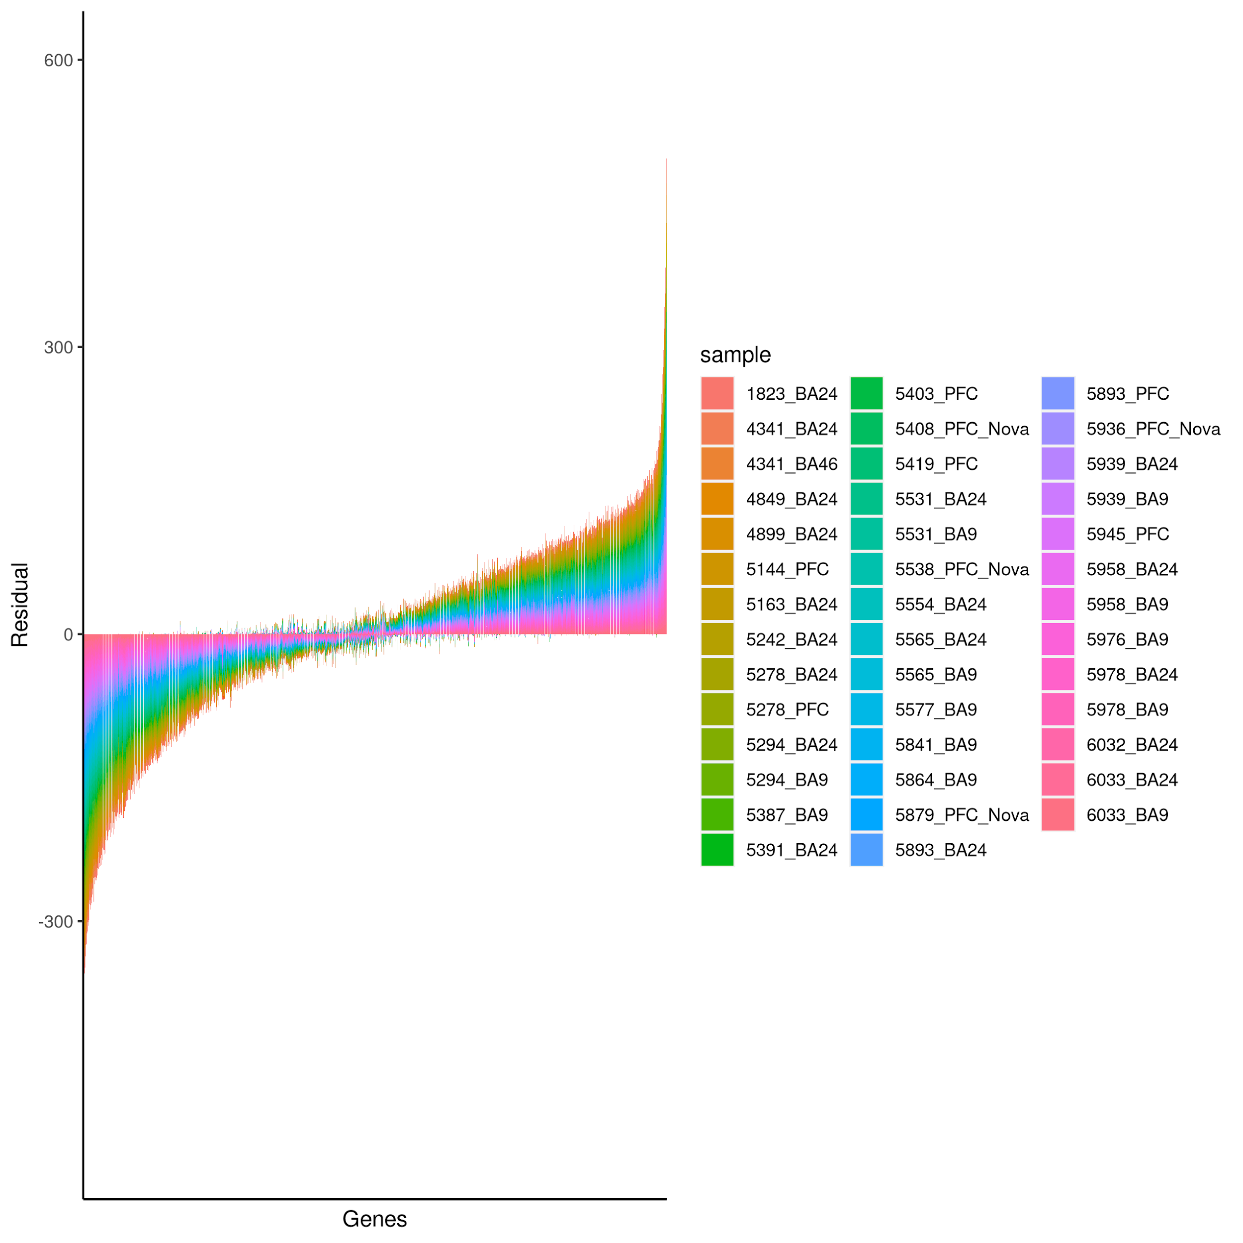
Linear Regression Outliers
91% of genes (33,217) are outliers in at least 1 sample
39% (14,026) are outliers in at least ⅔ of samples
20% (7095) are more lowly expressed in bulk data
19% (6893) are more highly expressed in bulk data
Upregulated in bulk (>3rd quartile)
The mean of the residuals is approximately 0, indicating no significant tendency for genes to be differentially expressed in one direction.
Downregulated in bulk (<1st quartile)

Slide 20
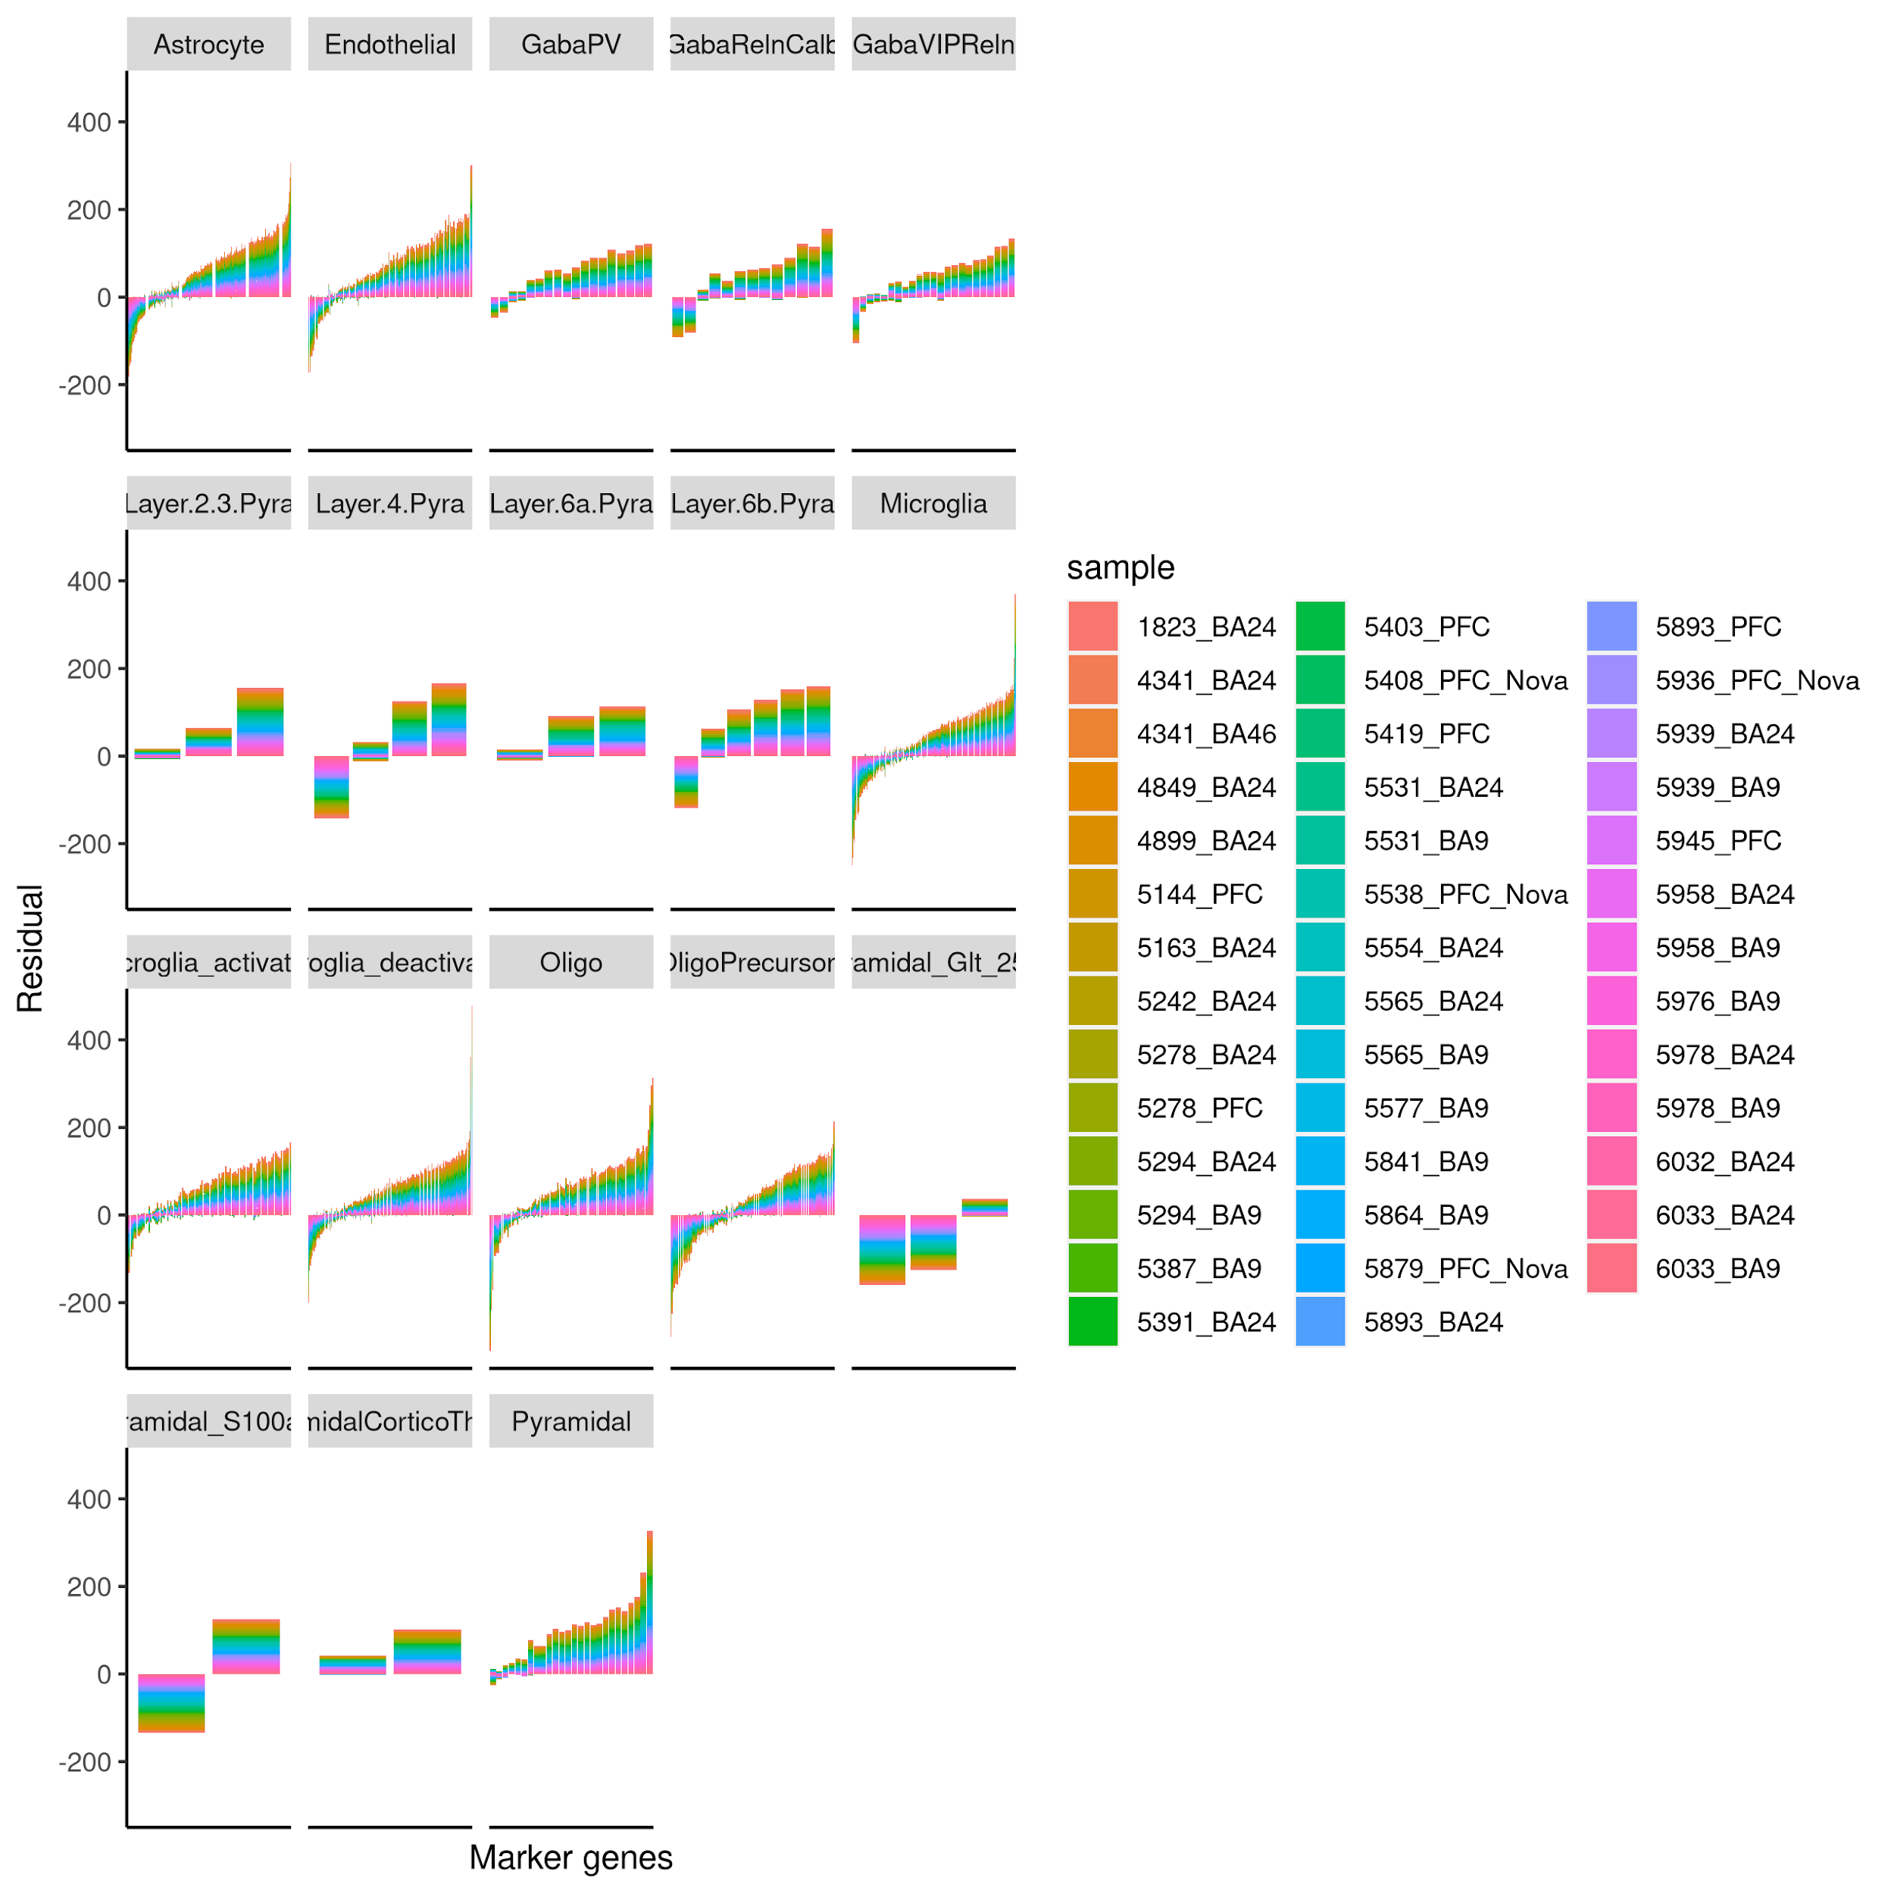
Linear Regression Outliers
For outliers that are also cell type markers, the shift is significantly greater than 0 in most cell types (one-sided Mann-Whitney test p << 0.05) and significantly correlated between individuals, indicating that cell type marker genes tend to be expressed more lowly in bulkized data.

Slide 21
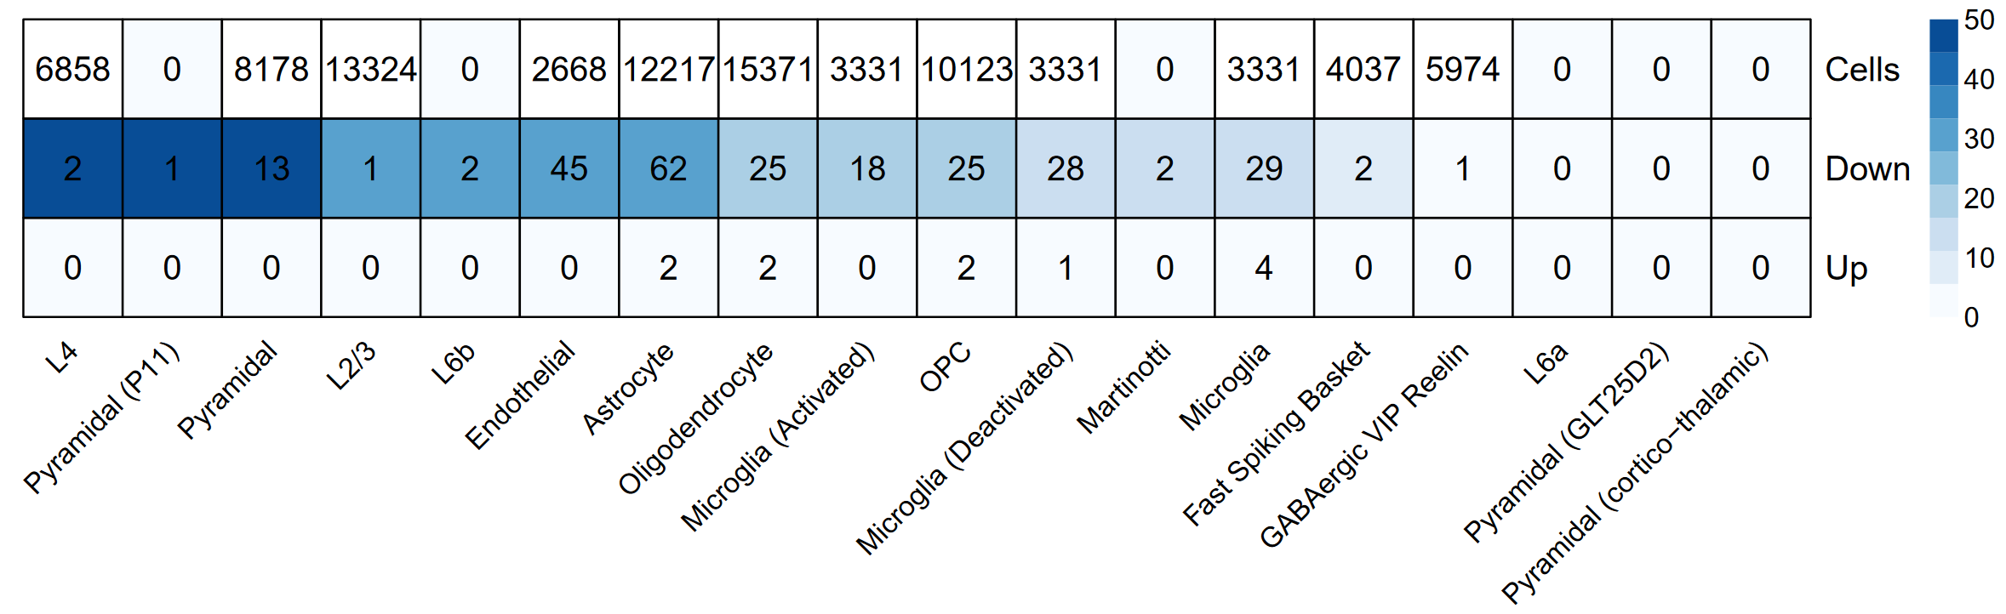
Overrepresentation of Cell Type Markers (DE)
There is no significant correlation between the number of cells per cell type and the number of differentially expressed marker genes per cell type (Pearson's product-moment correlation, p > 0.05) and a strong signature of decreased expression in bulkized data.

Slide 22
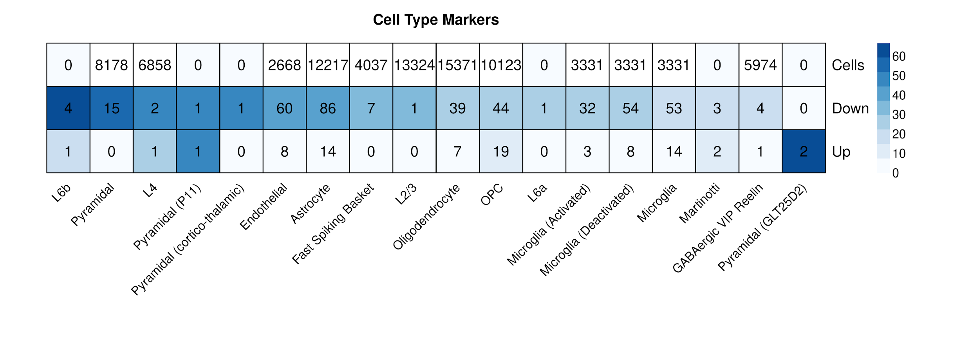
Overrepresentation of Cell Type Markers (Linear Regression)
There is a strong, significant correlation between markers detected with decreased expression in bulk using linear regression as in differential expression analysis (r² = 0.98, p << 0.05).
Notes:
P ~ 3.35e-13

Slide 23
Discussion and Conclusions

Slide 24
General Decrease of Expression in All Cell Types
Interestingly we observe a significant pattern of down-regulation in bulkized single-cell data (as compared to bulk data) for most cell types with known markers.
This signature of down-regulation does not correlate with the number of cells or number of markers.
Another way to examine cell-type biases would be to look at differential expression of cell type-specific processes using GO terms, such as is done by Ilicic et al¹.
This type of analysis may be sensitive to the inherent difference in data type (single nucleus vs bulk tissue).
May also be some cellular contamination in single cell data.
Ilicic T et al. 2016. Classification of low quality cells from single-cell RNA-seq data. Genome Biol 17. DOI:10.1186/s13059-016-0888-1

Slide 25
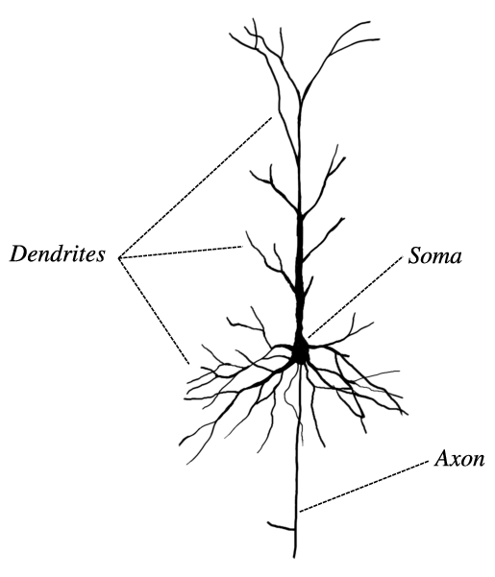
Pyramidal Cell Subtypes Have Most Significant Bias
In the DroNuc-Seq protocol used for this dataset, the cellular suspension is chemically lysed before nuclei are isolated by centrifugation.
Therefore, this may be explained by:
Chemical and physical properties of the membrane How: pyramidal-specific channels and other molecules can alter membrane properties, making them less susceptible to generic lysis buffers
Irregular branching shape How: if cells are more likely clump together in the suspension, they can be shielded from lysis buffer

Slide 26
Weaknesses
Can’t conclude this is truly due to technical differences (ie. in library prep.) correlation ≠ causation!
More datasets needed to generalize findings this snRNAseq preparation may not be representative of the population; N = 1
Inherent unsuitability of this data for this task general expression bias; may be better to quantify by staining after prep. instead of sequencing at all

